Slide 1





ISARUIT
Website Launch
Presented by: Beverly Illauq
Date:
Website:
December 4, 2025
www.isaruit.ca

Slide 2
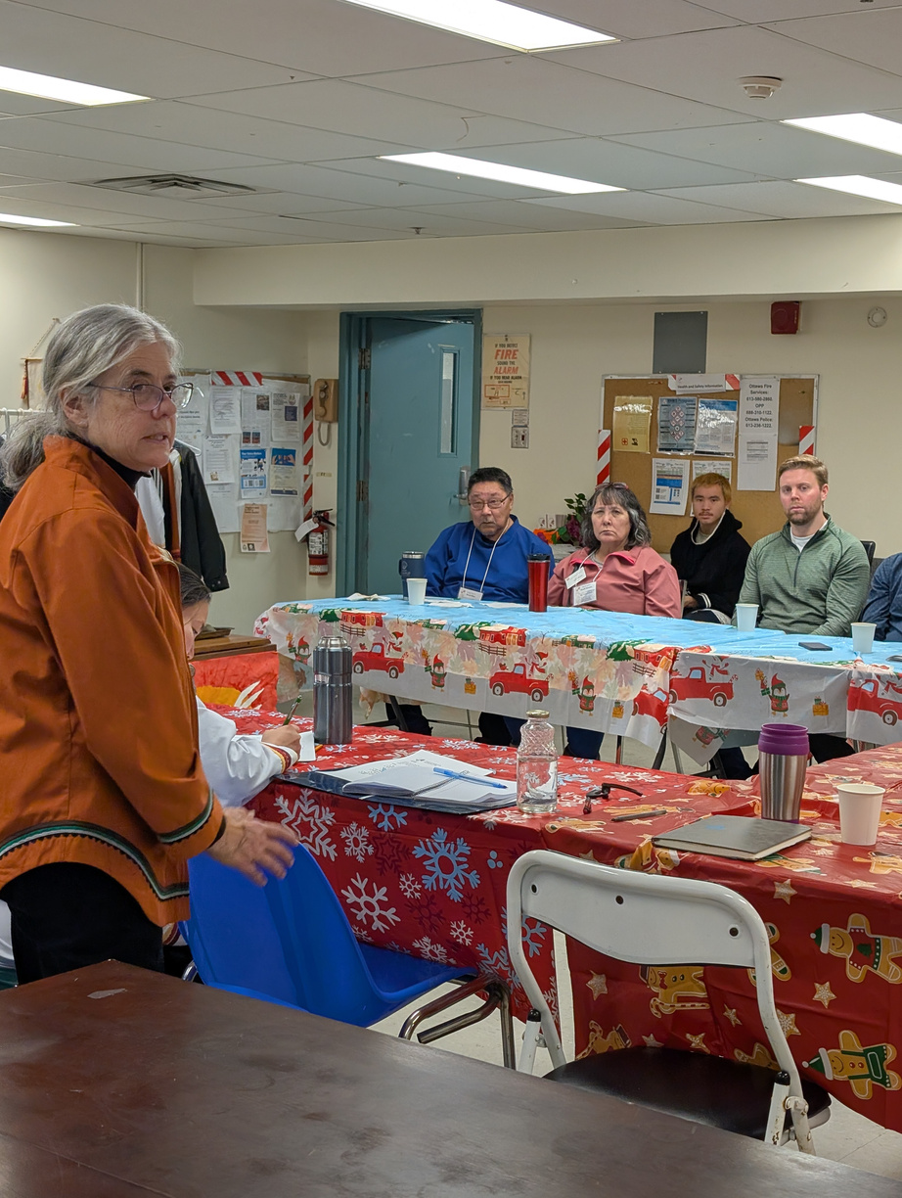

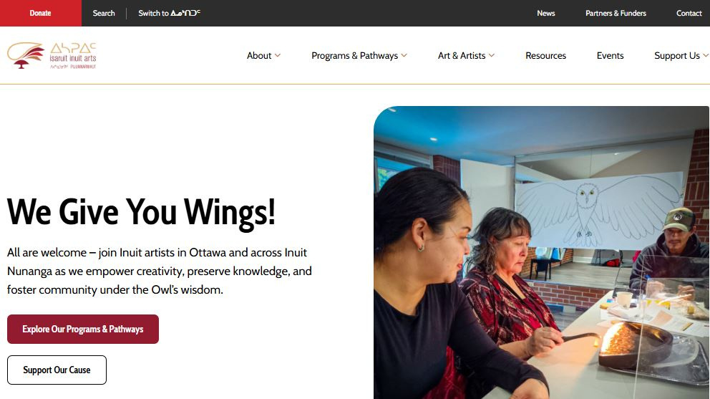
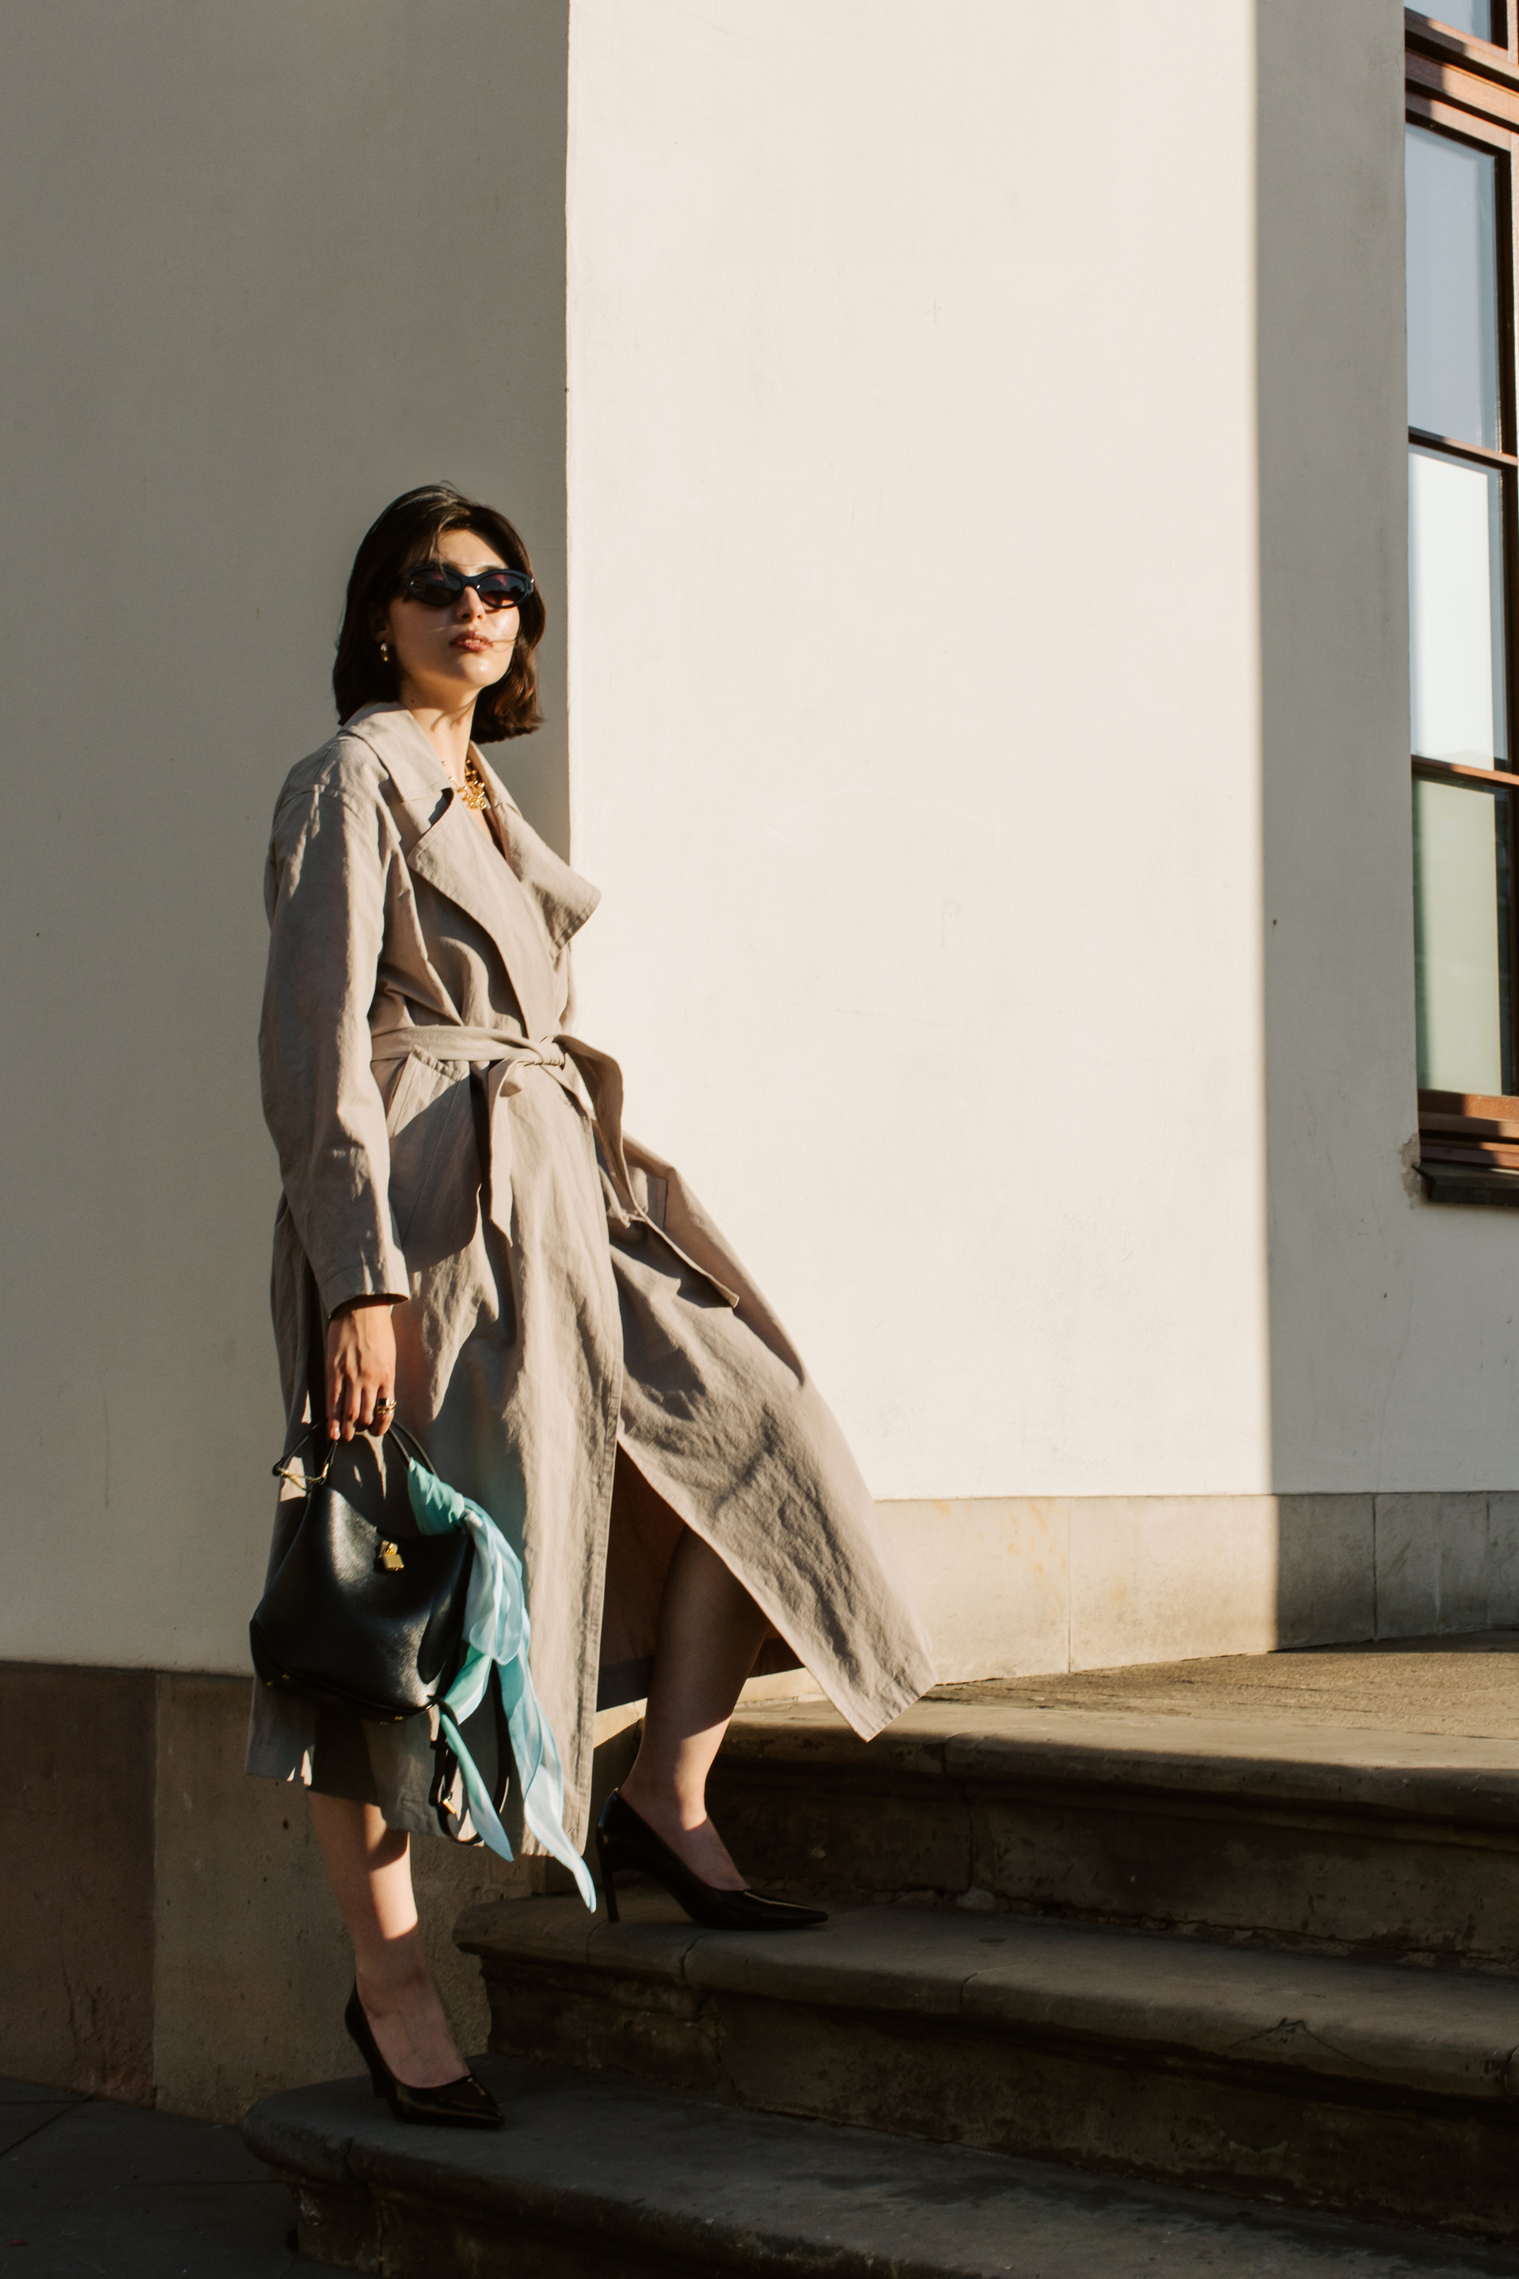
Isaruit Inuit Arts Website Launch
On Wedensday December 3, 2025 Isaruit Inuit Arts officially launched our newly redesigned website—a project that reflects months of hard work, dedication, and collaboration.
This refresh isn’t just cosmetic. It’s a meaningful upgrade to how we tell our story, support our users, and showcase the work that drives our organization forward. The new site is cleaner, easier to navigate, and built with our community in mind.
www.isaruit.ca

Slide 3

Guided by Inuit Qaujimajatuqangit Principles
www.isaruit.ca

Slide 4
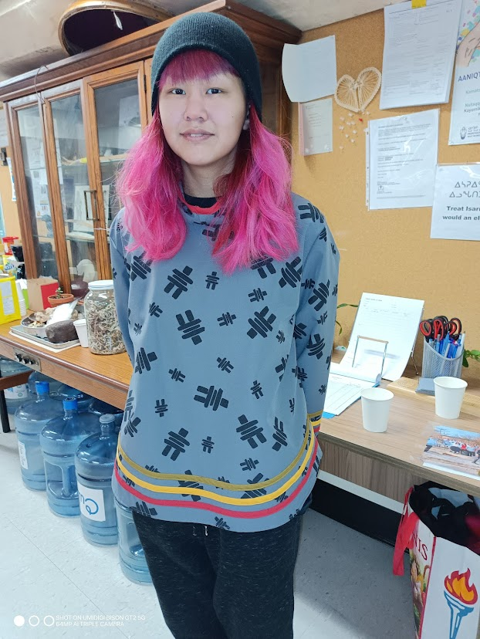
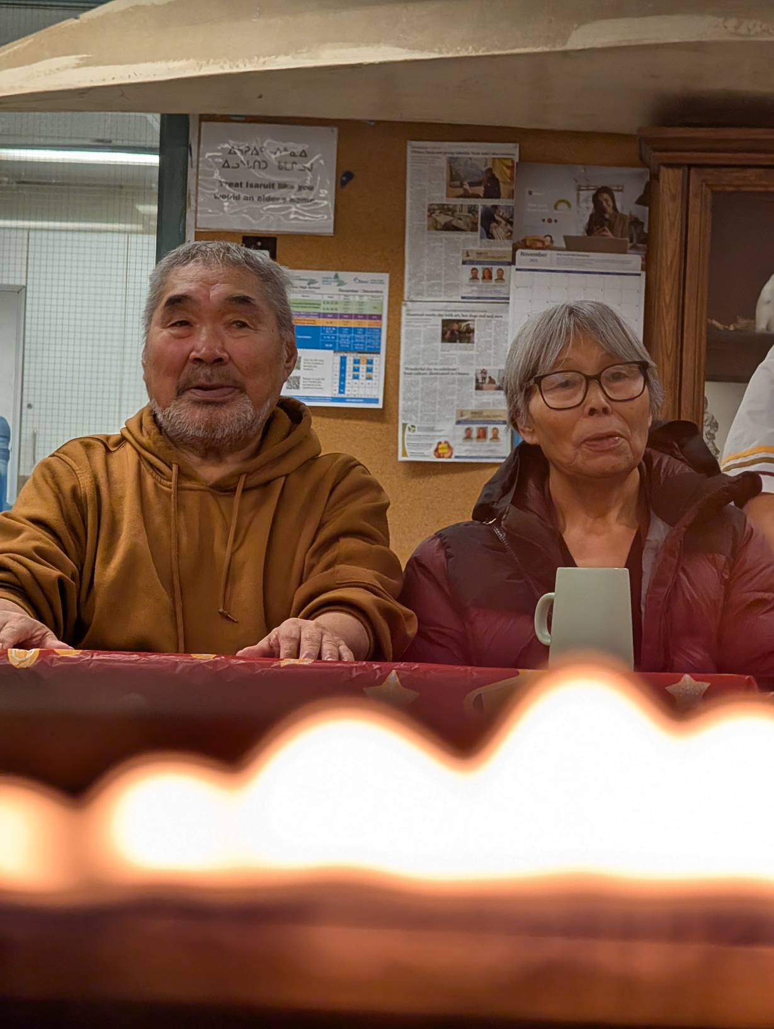

Vision
&
Mission
www.isaruit.ca
Our Vision
Our Mission
  To honor Inuit identity through art: Isaruit is founded on the spirit of restoration, reconciliation, and reconnection.
  To provide a safe and welcoming space: They aim to create a community for Inuit artists to practice skills and support one another.
  To ensure Inuit voices are celebrated: Their goal is to nurture the growth of Inuit creators and ensure their voices are respected and heard.
  To inspire lifelong creativity and learning: This is achieved by sharing Inuit traditions, knowledge, and language through the arts.
  To empower Inuit artists: They focus on skill development and community support to nurture artistic talents and preserve cultural heritage.
  To foster a strong sense of community: Through shared experiences, mentorship, and programs, they connect Inuit artists in Ottawa and beyond.

Slide 5
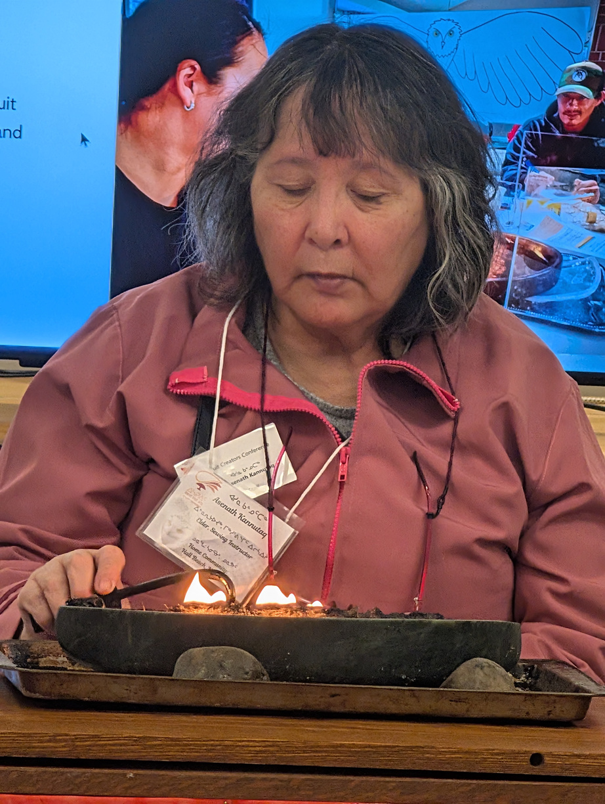
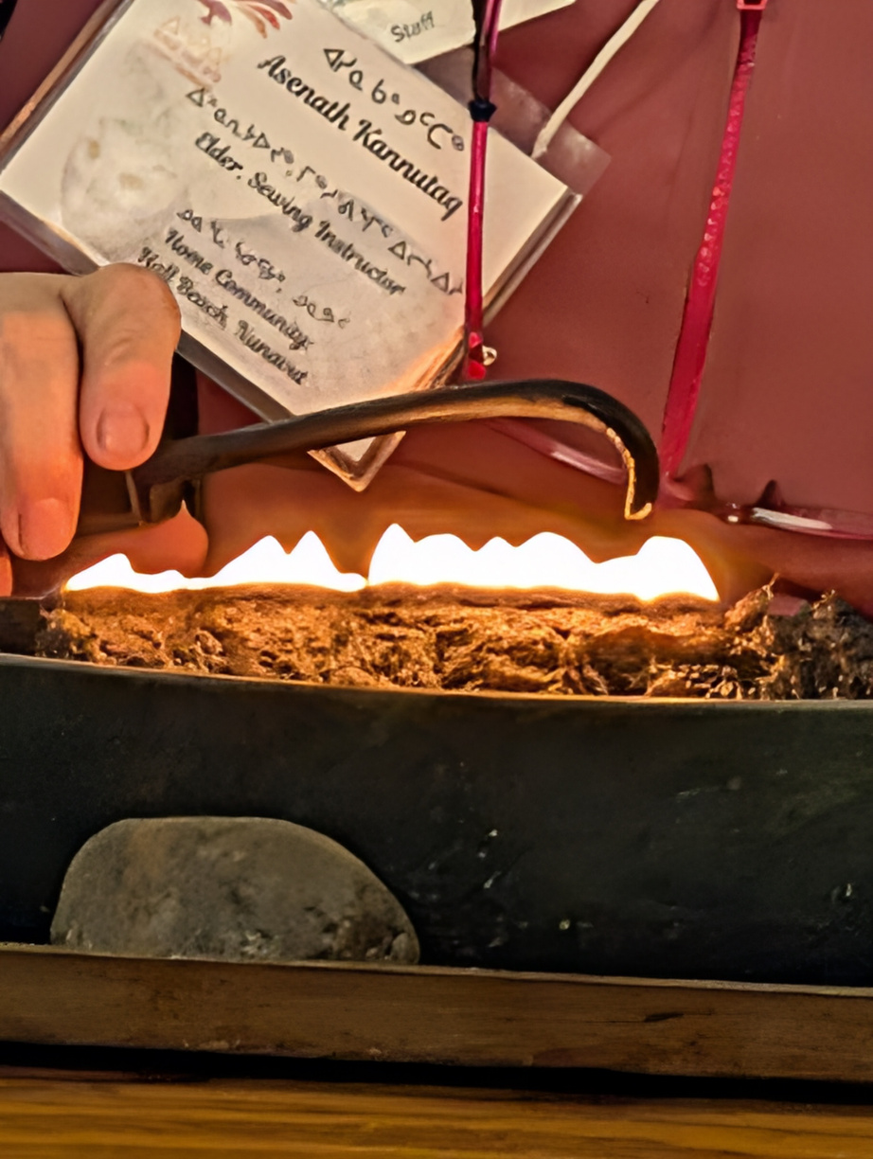
Lighting the Qulliq
www.isaruit.ca

Slide 6
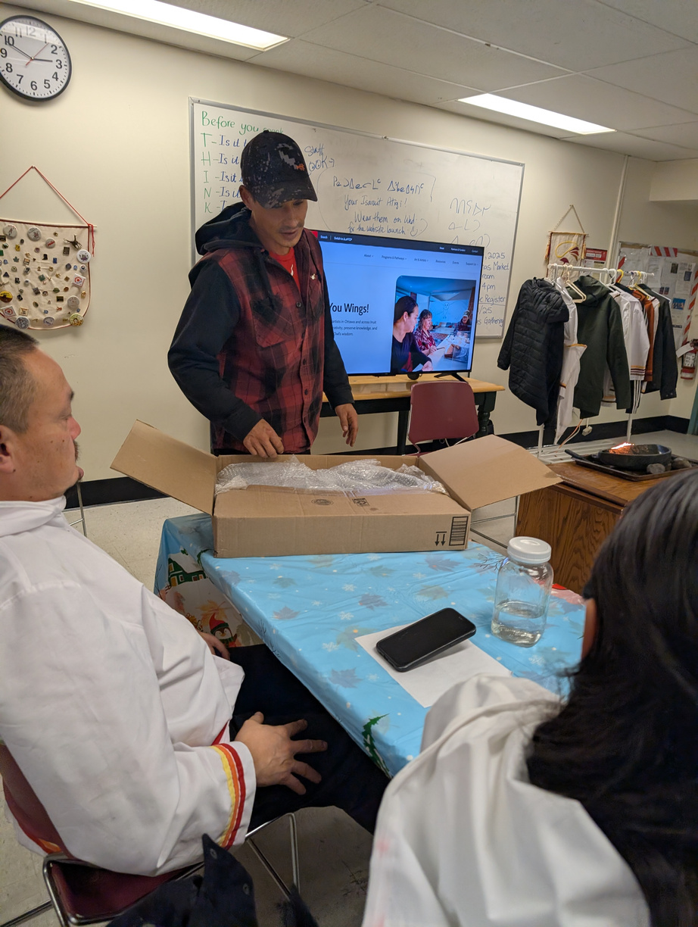
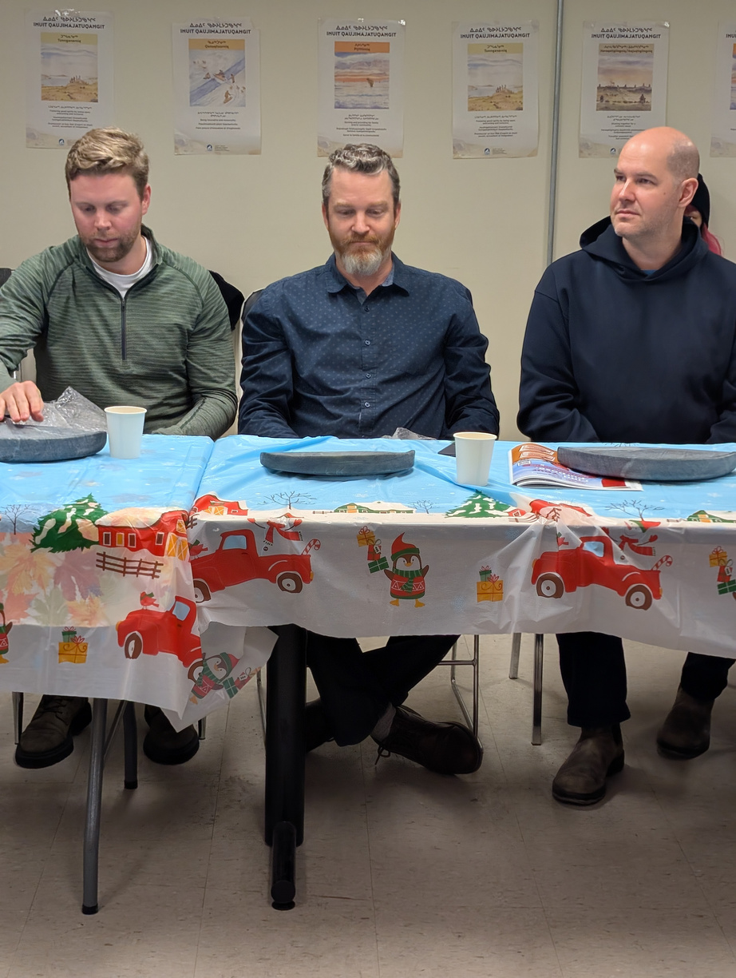
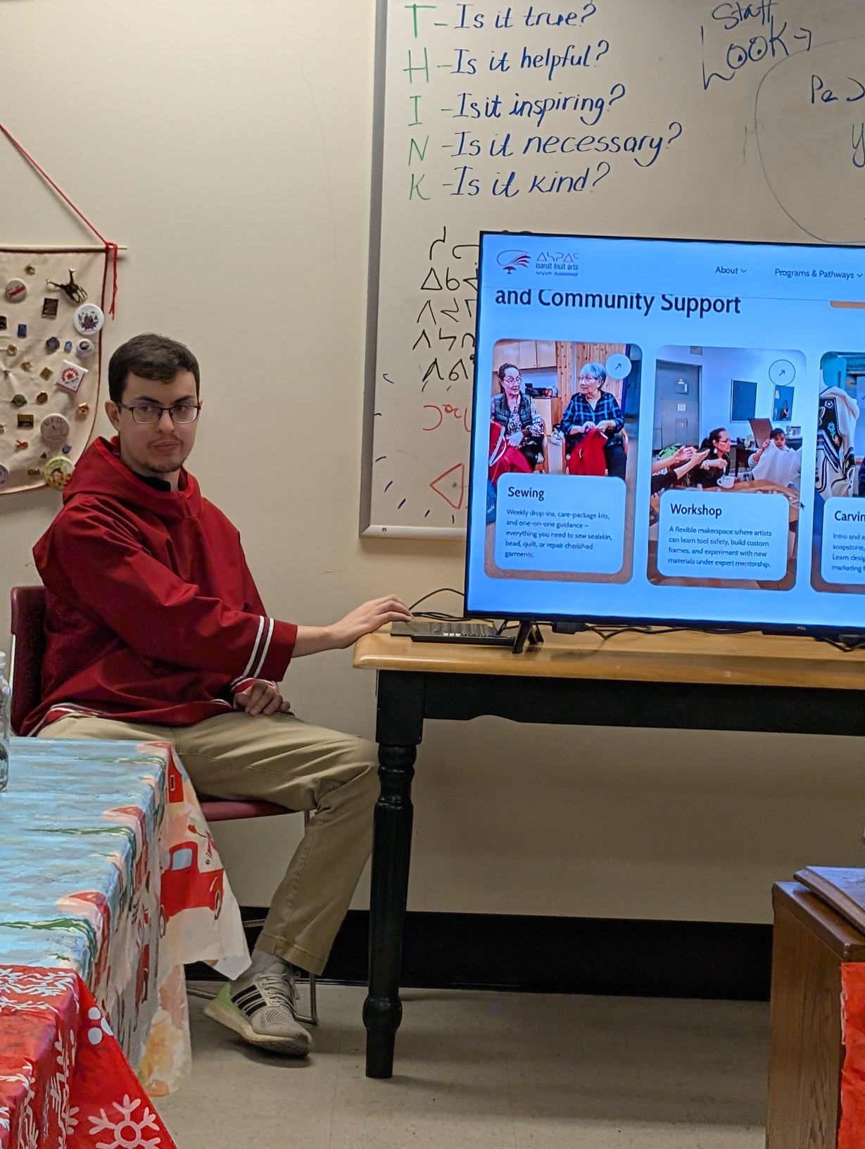
Hardwork Recognized
www.isaruit.ca

Slide 7
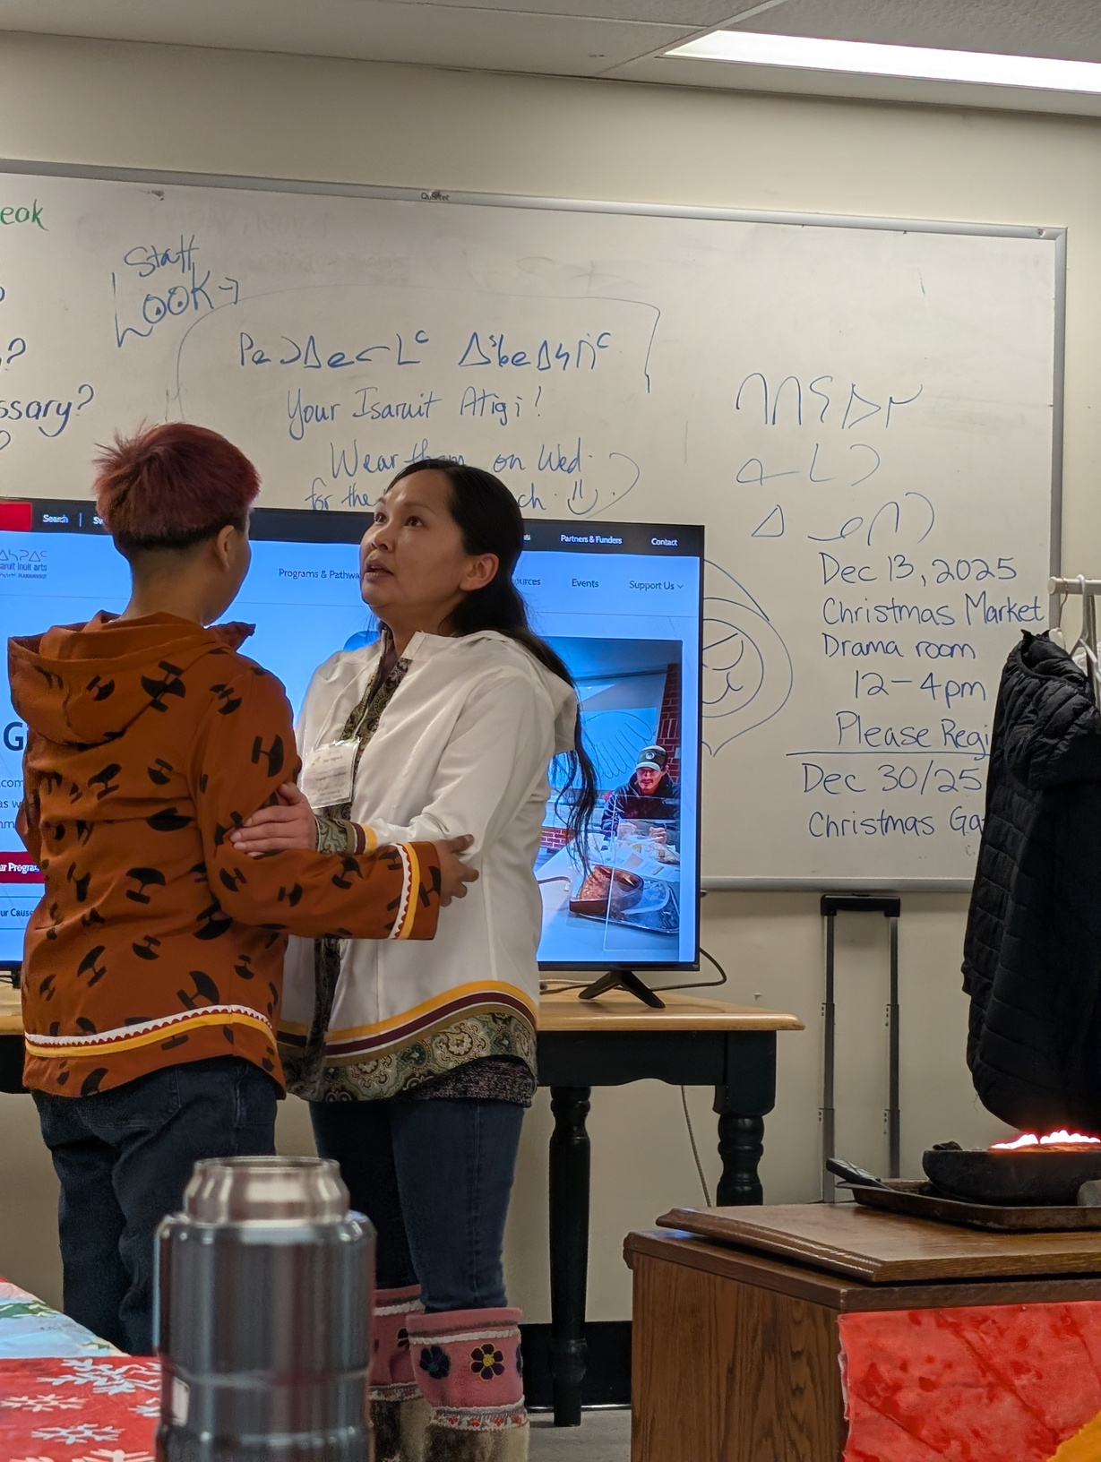
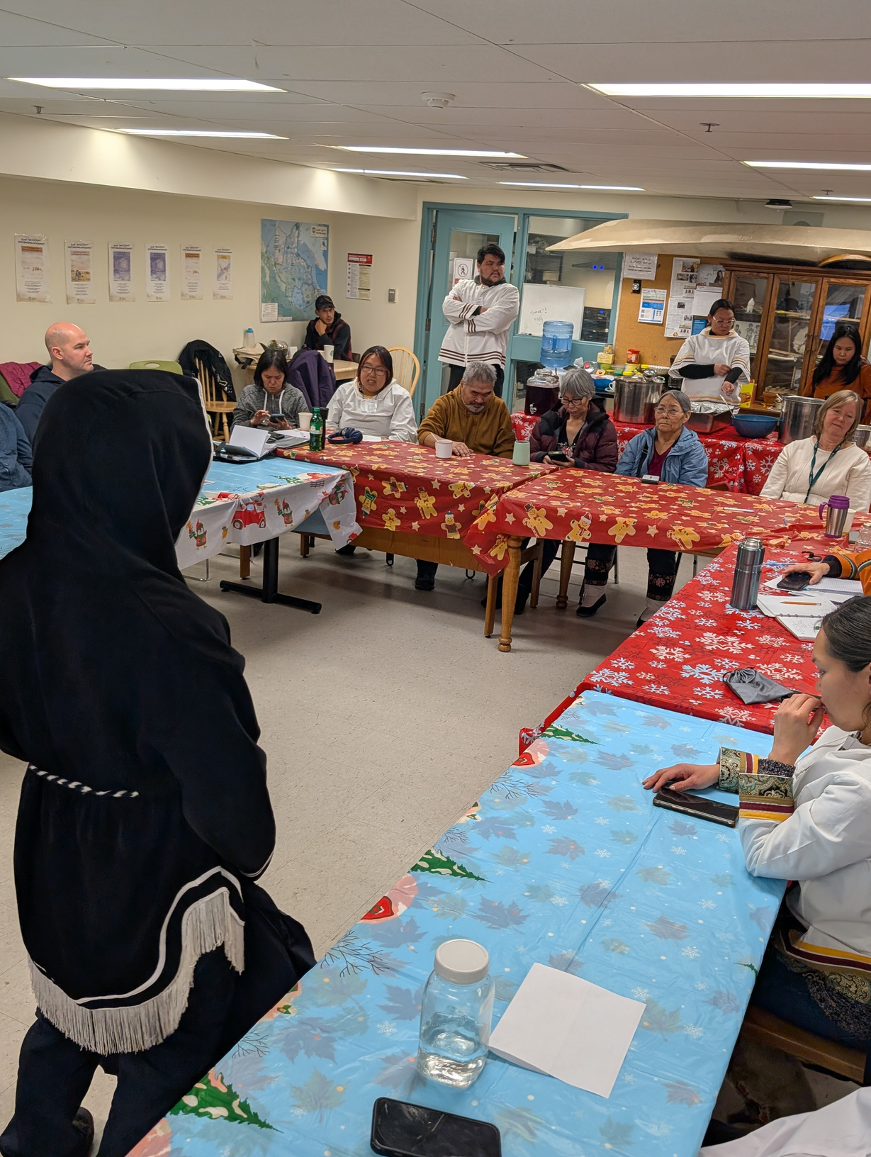
Entertainment

Slide 8
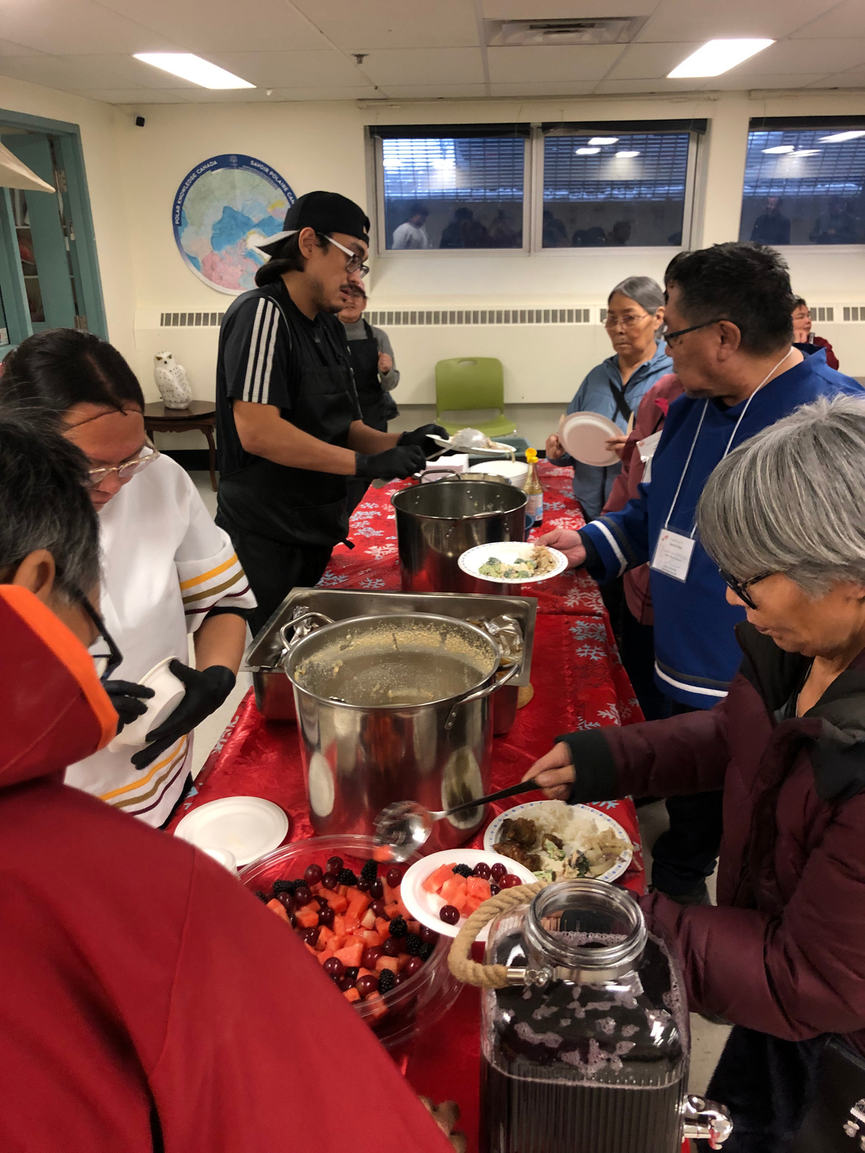
Feast

Slide 9
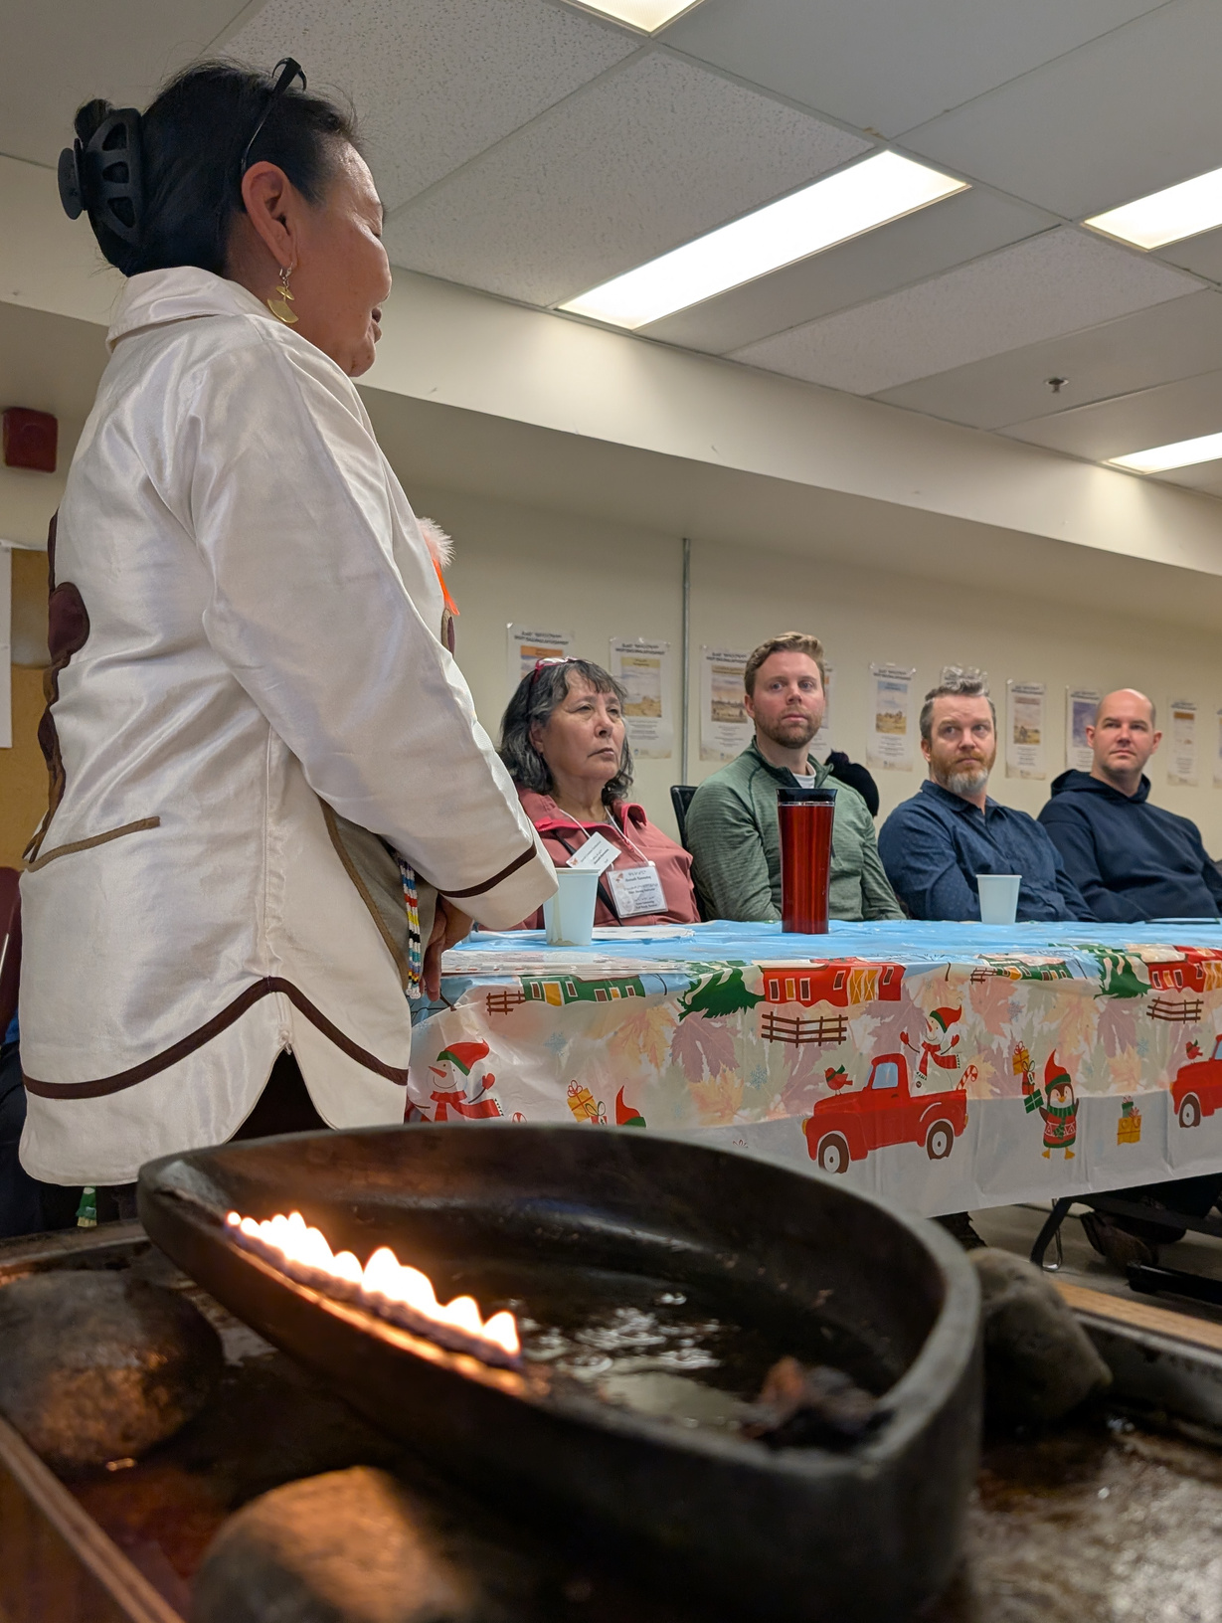
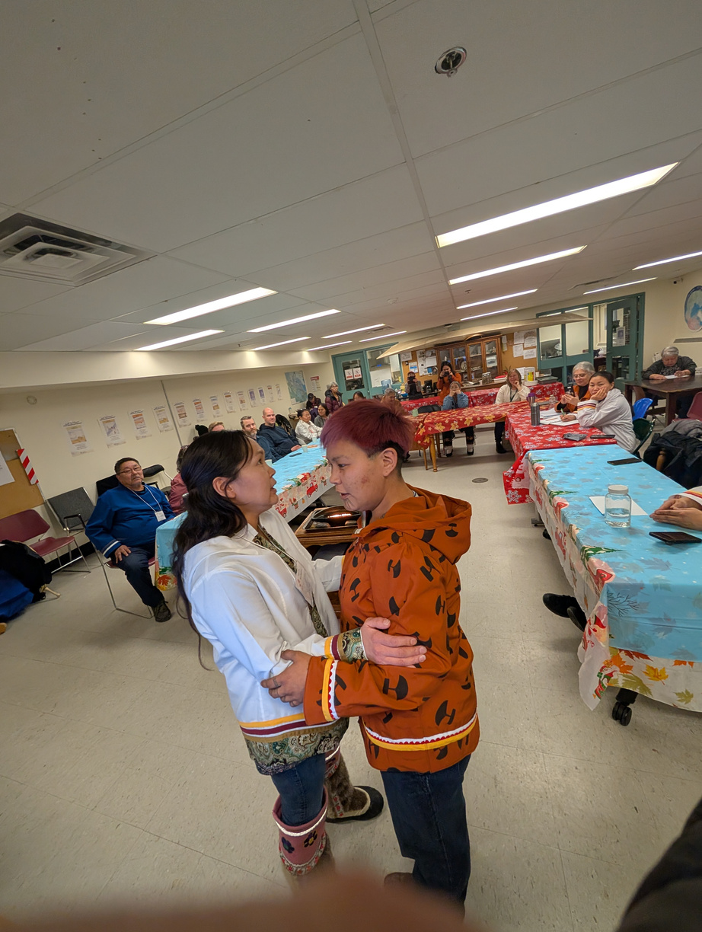
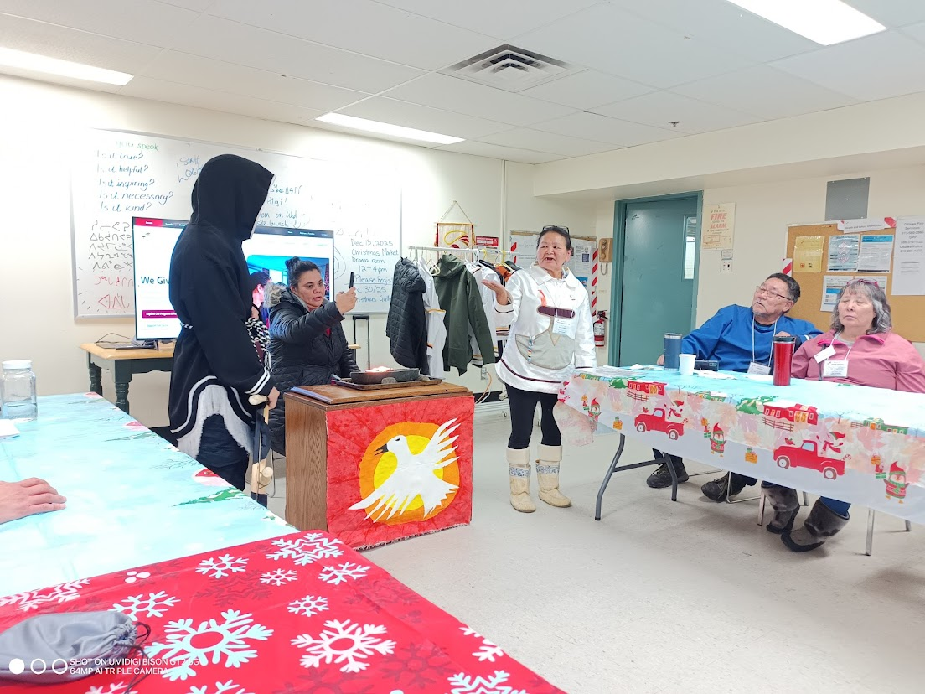
“The reason we started was because there were many inuit that wanted to start sewing again at the same time because from a young age in Nunavut you have to learn and practice sewing. It’s our tradition to start sewing early and it’s also a form of healing, cultural healing. Now Isaruit is well known by Inuitmiu and becoming more well known to Ottawamiut.”
Aigah Attagutsiaq, Co-Founder of Isaruit Inuit Arts
www.isaruit.ca

Slide 10
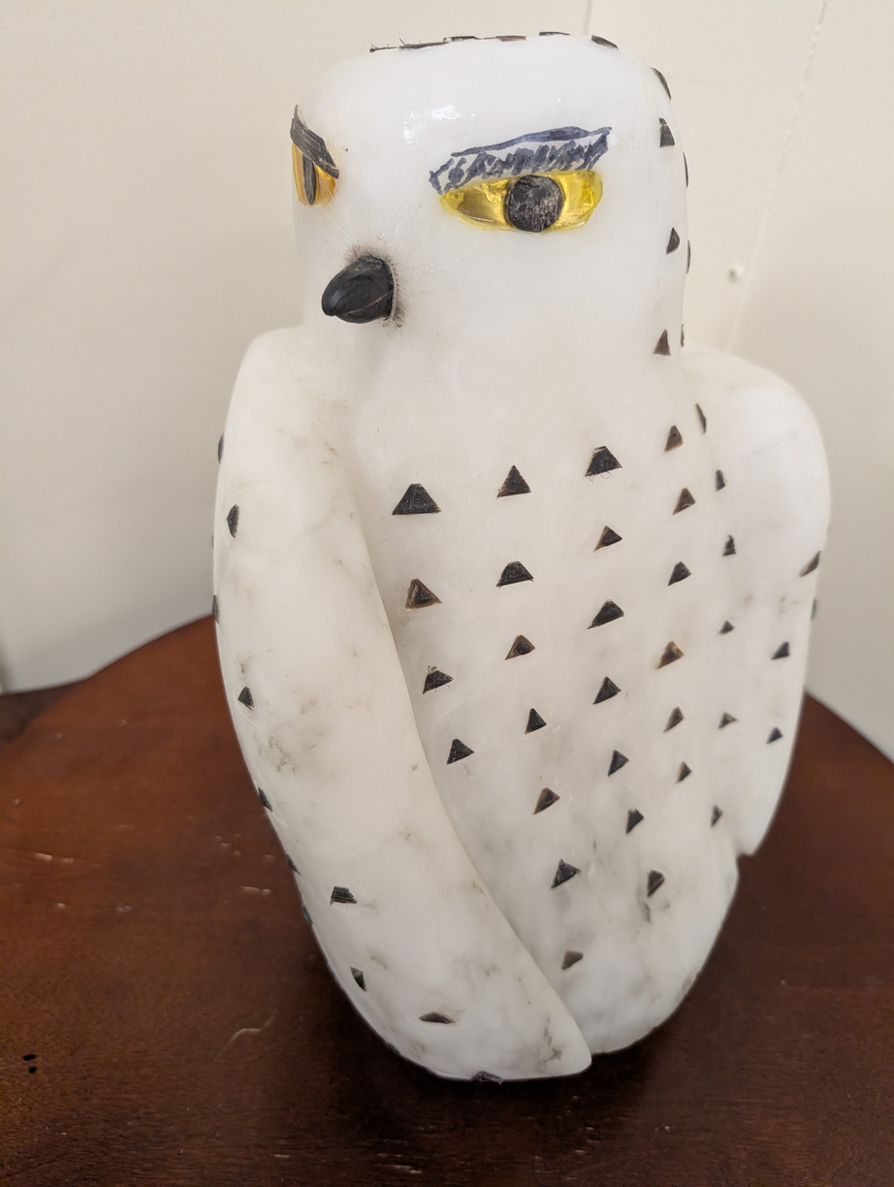
Get in touch
Website:
Email:
Contact:
www.isaruit.ca
info@isaruit.ca
613-974-2787
QUJANNAMIIK! THANK YOU!

